Slide 1
DevOps culture Organizing DevOps Teams and Architecture According to Conway’s Law
Notes:
Author: Ahmed Hosni
1

Slide 2
Agenda
Part 1:
Problems Often Caused by Overly Functional Orientation (‘Optimizing for Cost’).
Enable Market-Oriented Teams (‘Optimizing for Speed’).
Making Functional Orientation Work.
Testing, Operations, and Security as Everyone’s Job, Every Day.
Design Team Boundaries in Accordance with Conway’s Law.
Enable Every Team Member to Be a Generalist.
Rethink team structures, purpose and interaction
Case studies: Spotify and Amazon.
Part 2:
Pairing and mobbing: Discuss and experience 3 foundational practices
Demo day: Experiment with the optimal methods of producing a showcase.
Retrospectives, information radiators, and team sentiment
Workshop
2

Slide 3
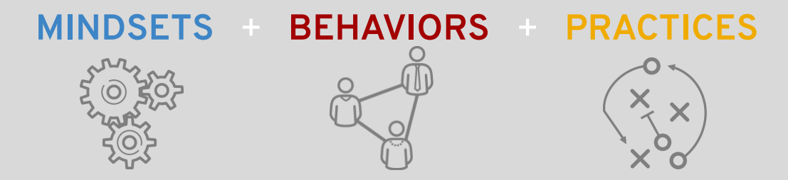
What are the Cultural Values of DevOps?
There are certain cultural principles and values of DevOps, that are intertwined with the values of Open Source communities, how open source projects work and agile ways of working, that can create a DevOps culture.

Slide 4
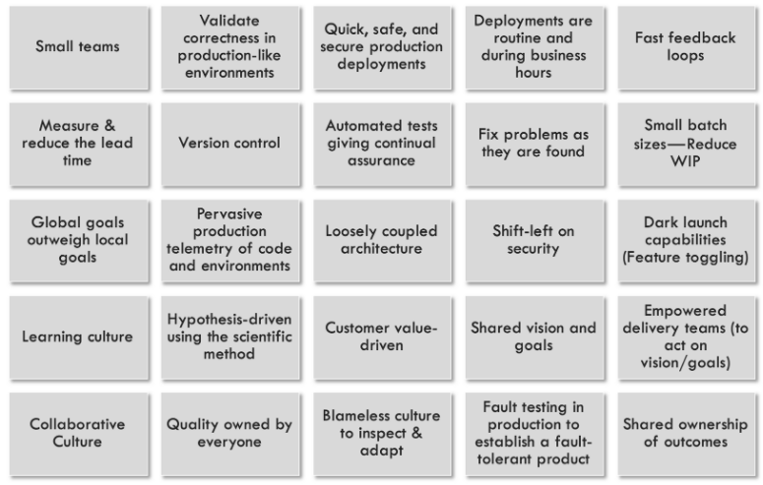
From ‘The DevOps Handbook’
DevOps Practices

Slide 5
Organizational patterns for DevOps
Notes:
Author: Ahmed Hosni
5

Slide 6
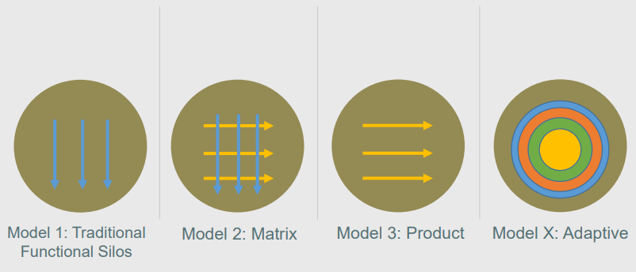
Organizational structures

Slide 7
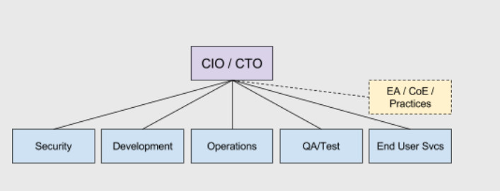

MODEL 1: Functional Silos

Slide 8
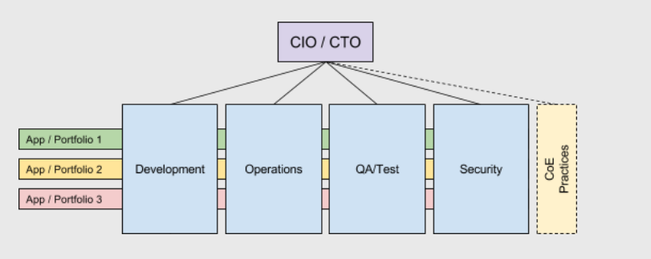

MODEL 2A: Matrix

Slide 9
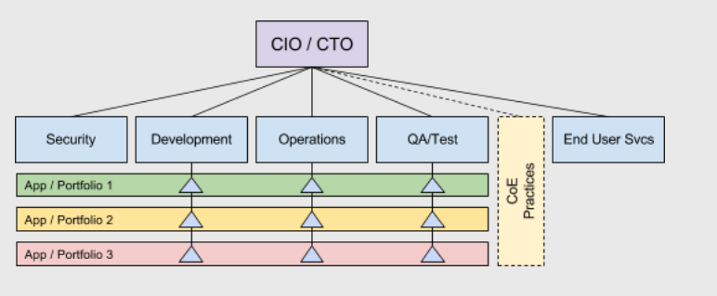
MODEL 2B: Matrix Embedded Functions

Slide 10
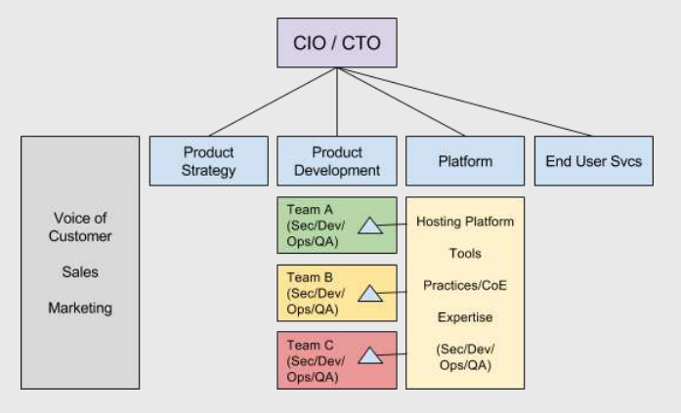

MODEL 3: Product

Slide 11
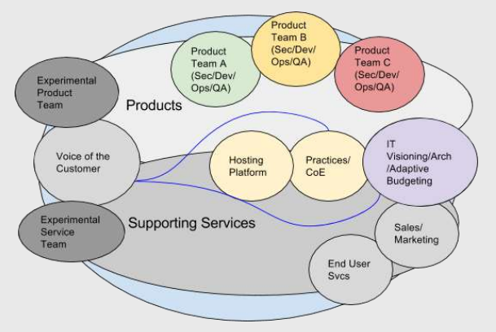

MODEL X: Adaptive

Slide 12
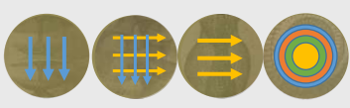
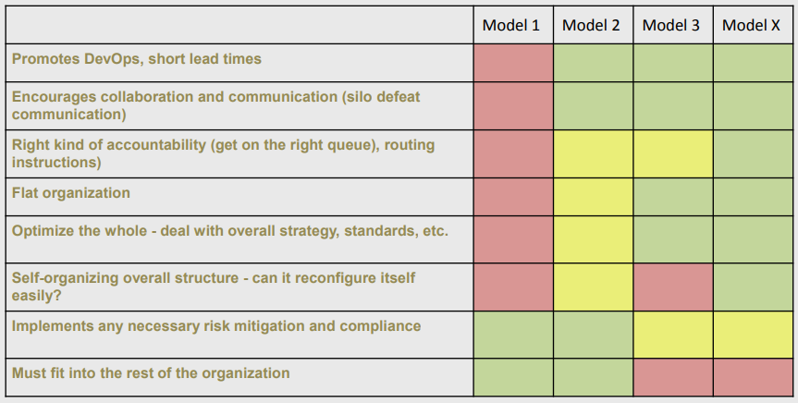
SUMMARY

Slide 13
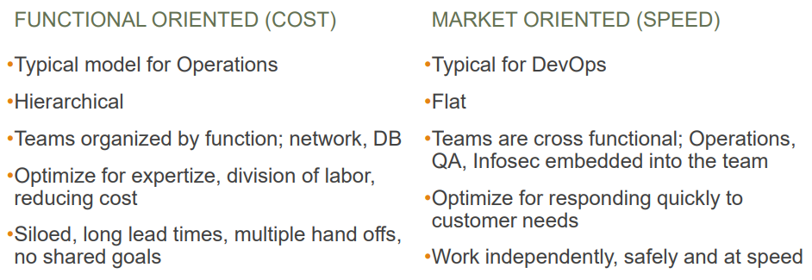
Axe’s organizational archetype?

Slide 14
Problems Often Caused by Overly Functional Orientation (‘Optimizing for Cost’)
Notes:
Author: Ahmed Hosni
14

Slide 15
Pain Points
When we put the database administrators in one group, the network administrators in another, the server administrators in a third, and so forth – one of the most visible consequences is long lead times.
Especially for complex activities like large deployments where we must open up tickets with multiple groups and coordinate work handoffs, resulting in our work waiting in long queues at every step.

Slide 16
Pain Points
In addition to these long queues and long lead times, this situation results in:
- Poor handoffs
- Large amounts of re-work,
- Quality issues,
- Bottlenecks and delays.
This gridlock impedes the achievement of important organizational goals, which often far outweigh the desire to reduce costs.

Slide 17
Pain Points
Similarly, functional orientation can also be found with centralized QA and Infosec functions, which may have worked fine (or at least, well enough) when performing less frequent software releases.
As the number of Development teams increase along with their deployment and release frequencies, most functionally-oriented organizations will have difficulty keeping up and delivering satisfactory outcomes, especially when their work is being performed manually.

Slide 18
Enable Market-Oriented Teams (‘Optimizing for Speed’)

Slide 19
Market-orientated teams
Taken to the extreme, market-oriented teams are responsible not only for feature development, but also for testing, securing, deploying, and supporting their service in production, from idea conception to retirement.
This model has been adopted by Amazon and Netflix and is touted by Amazon as one of the primary reasons behind their ability to move fast even as they grow.
Notes:
These teams are designed to be cross-functional and independent—able to:
design and run user experiments,
build and deliver new features,
deploy and run their service in production,
and fix any defects without manual dependencies on other teams, thus enabling them to move faster.

Slide 20
Market-orientated teams
To achieve market orientation, we won’t do a large, top-down reorganization, which often creates large amounts of disruption, fear, and paralysis.
Instead, we will embed the functional engineers and skills (e.g., Ops, QA, Infosec) into each service team, or provide their capabilities to teams through automated self-service platforms that provide production-like environments, initiate automated tests, or perform deployments.

Slide 21
Market-orientated teams
However, having just recommended market-orientated teams, it is worth pointing out that it is possible to create effective, high-velocity organizations with functional orientation.
Many of the most admired DevOps organizations retain functional orientation of Operations, including Etsy, Google, and GitHub.
These organizations have in common a high-trust culture that enables all departments to work together effectively, where all work is transparently prioritized and there is sufficient slack in the system to allow high-priority work to be completed quickly.

Slide 22
Overcoming Objections Making Functional Orientation Work

Slide 23
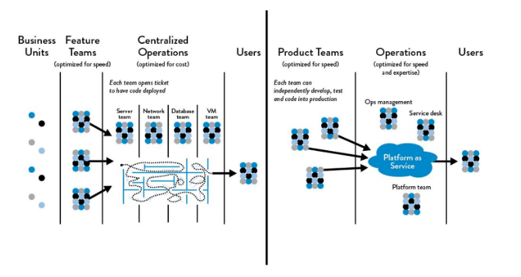
Do not dismiss functional-orientation entirely
Functional vs. Market Orientation Work: The DevOps Handbook (1st ed. 2016) Kim et al.
Notes:
In the right high-trust culture, organizations can achieve high-velocity, effective work flow by enabling automated self-service platforms and promoting full transparency in work prioritization.

Slide 24
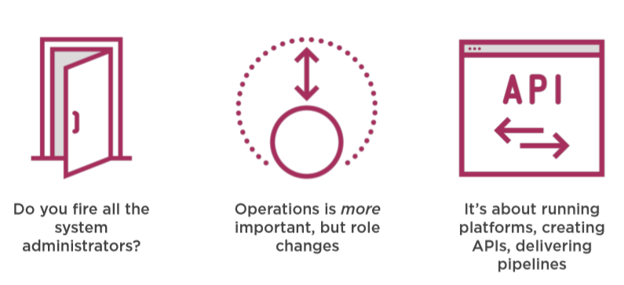
Objection: “You’re eliminating our Ops team.”

Slide 25
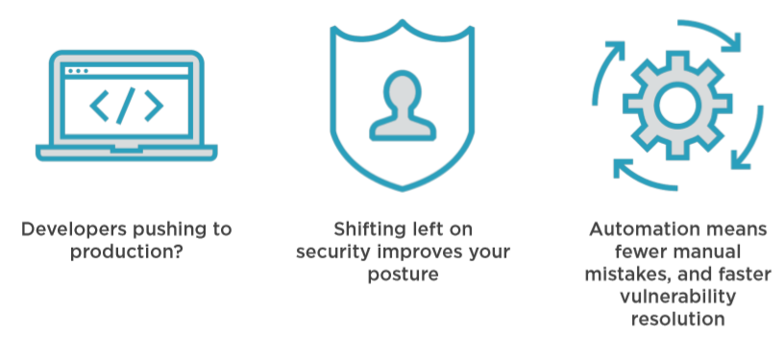
Objection: “DevOps makes us less secure.”

Slide 26
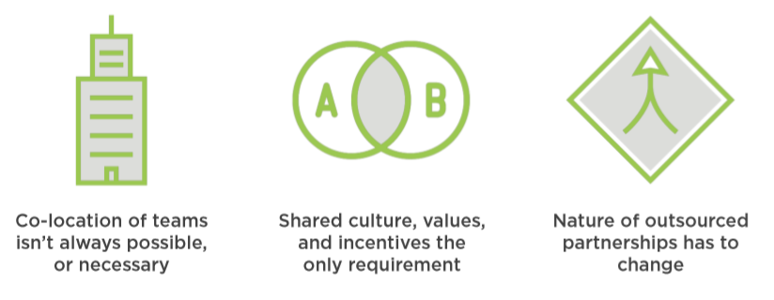
Objection: “We have offshore teams.”

Slide 27
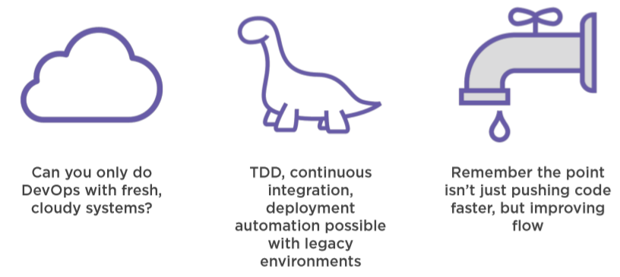
Objection: “I’ve got too much COTS and legacy code.”

Slide 28
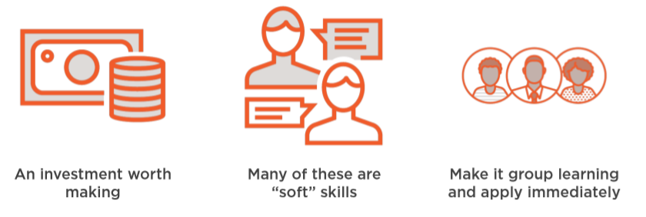
Objection: “We don’t have these skills.”

Slide 29
DevOps Team Topologies

Slide 30
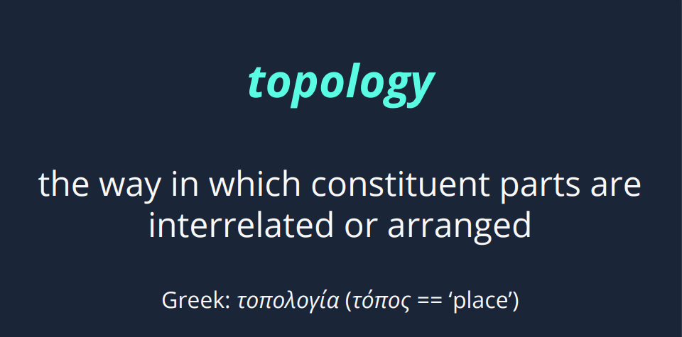

Slide 31
DevOps Anti-Types
It’s useful to look at some bad practices, what we might call ‘anti-types’ (after the ubiquitous ‘anti-pattern‘).
It’s useful to look at some bad practices, what we might call ‘anti-types’ (after the ubiquitous ‘anti-pattern‘).
A: Dev vs Ops
B: DevOps Silo
C: No Ops Needed
D: Tools Team
E: SysAdmin
F: Embedded Ops
G: Dev vs DBA

Slide 32
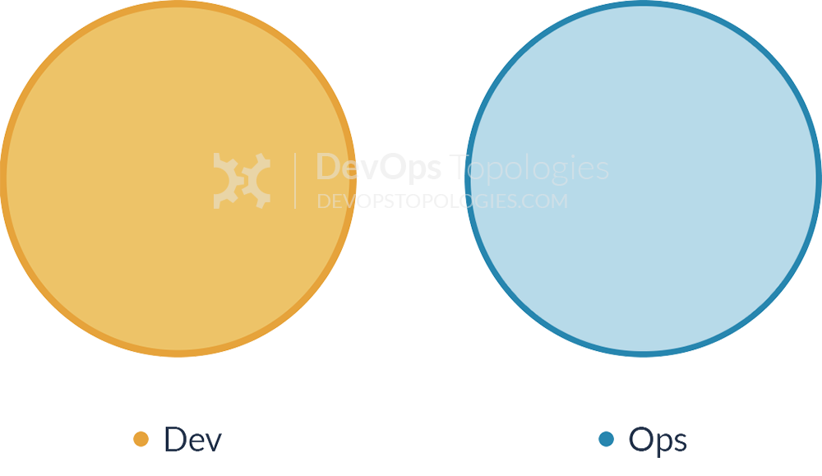
Anti-Type A: Dev and Ops Silos
It means that story points can be claimed early (DONE means ‘feature-complete’, but not working in Production), and software operability suffers because Devs do not have enough context for operational features and Ops folks do not have time or inclination to engage Devs in order to fix the problems before the software goes live.
Notes:
This is the classic ‘throw it over the wall’ split between Dev and Ops.
We likely all know this topology is bad, but I think there are actually worse topologies; at least with Anti-Type A (Dev and Ops Silos), we know there is a problem.

Slide 33
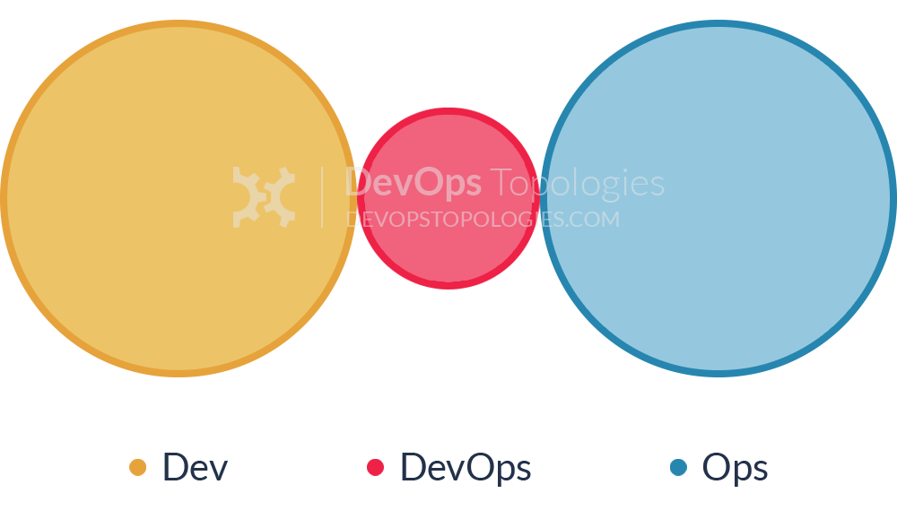
Anti-Type B: DevOps Team Silo
Typically results from a manager or exec deciding that they “need a bit of this DevOps thing” and starting a ‘DevOps team’ (probably full of people known as ‘a DevOp‘).
The members of the DevOps team quickly form another silo, keeping Dev and Ops further apart than ever as they defend their corner, skills, and toolset from the ‘clueless Devs’ and ‘dinosaur Ops’ people.

Slide 34
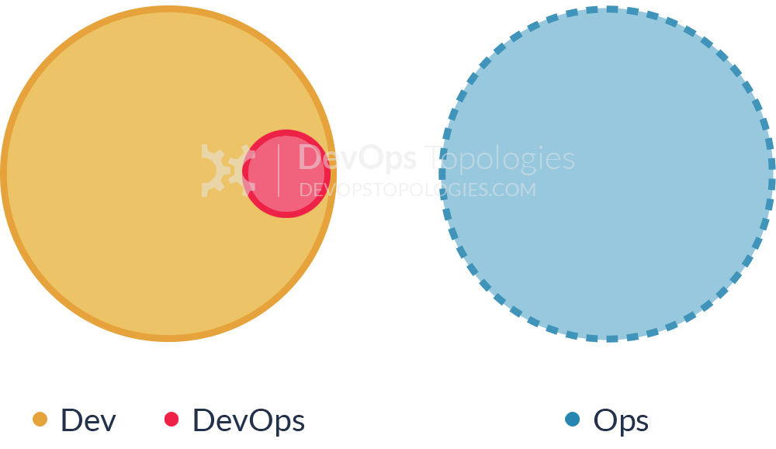
Anti-Type C: Dev Don't Need Ops
This topology is born of a combination of naivety and arrogance from developers and development managers, particularly when starting on new projects or systems
Assuming that Ops is now a thing of the past (“we have the Cloud now, right?”), the developers wildly underestimate the complexity and importance of operational skills and activities, and believe that they can do without them, or just cover them in spare hours.
Notes:
Such an Anti-Type C DevOps topology will probably end up needing either a Type 3 (Ops as IaaS) or a Type 4 (DevOps-as-a-Service) topology when their software becomes more involved and operational activities start to swamp ‘development’ (aka coding) time
If only such teams recognized the importance of Operations as a discipline as important and valuable as software development, they would be able to avoid much pain and unnecessary (and quite basic) operational mistakes.

Slide 35
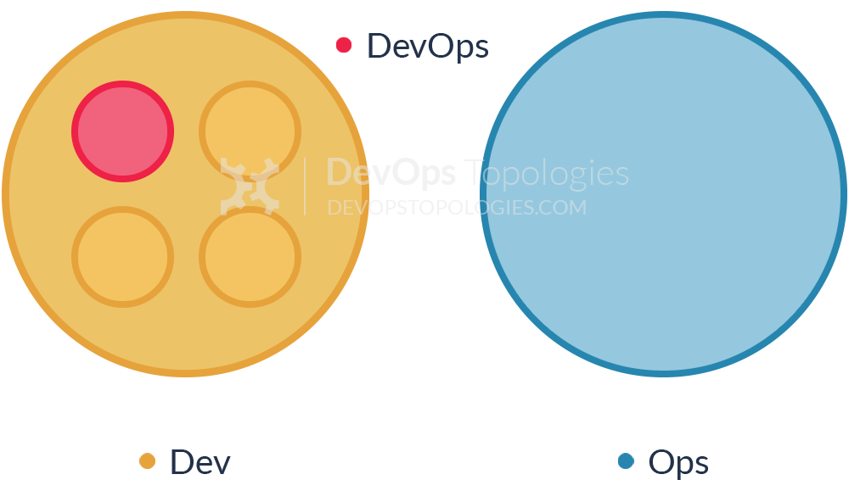
Anti-Type D: DevOps as Tools Team
In order to "become DevOps" without losing current dev teams velocity (read delivery of functional stories), a DevOps team is set up to work on the tooling required for deployment pipelines, configuration management, environment management, etc.
Meanwhile Ops folks continue to work in isolation and Dev teams continue to throw them applications "over the wall".
Notes:
Although the outcomes of this dedicated team can be beneficial in terms of an improved tool chain, its impact is limited.
The fundamental problem of lack of early Ops involvement and collaboration in the application development lifecycle remains unchanged.

Slide 36
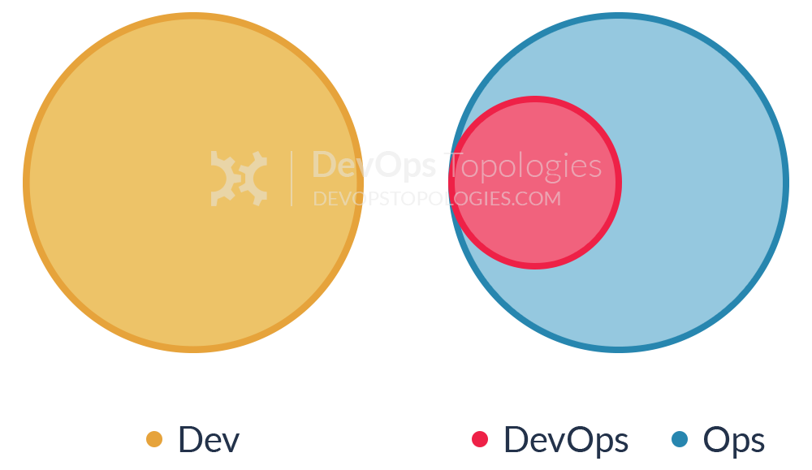
Anti-Type E: Rebranded SysAdmin
This anti-type is typical in organizations with low engineering maturity.
They want to improve their practices and reduce costs, yet they fail to see IT as a core driver of the business.
Because industry successes with DevOps are now evident, they want to "do DevOps" as well.
Unfortunately, instead of reflecting on the gaps in the current structure and relationships, they take the elusive path of hiring "DevOps engineers" for their Ops team(s).
Notes:
DevOps becomes just a rebranding of the role previously known as SysAdmin, with no real cultural/organizational change taking place.
This anti-type is becoming more and more widespread as unscrupulous recruiters jump on the bandwagon searching for candidates with automation and tooling skills.
Unfortunately, it's the human communication skills that can make DevOps thrive in an organization.

Slide 37
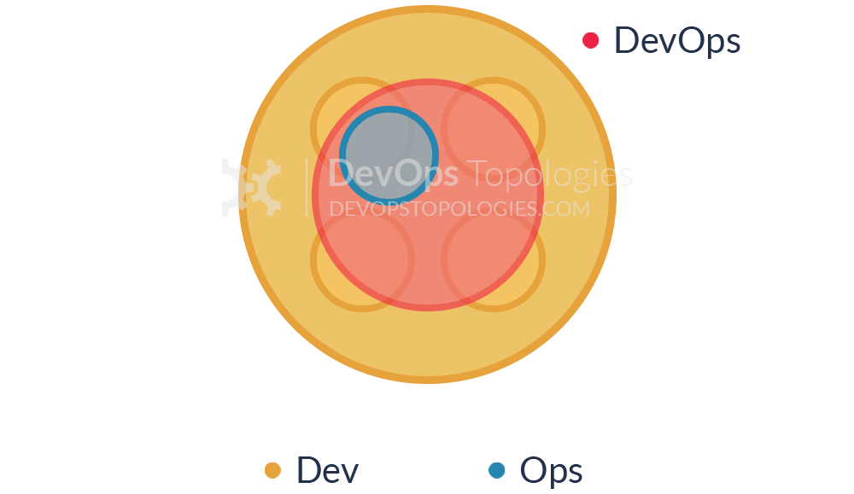
Anti-Type F: Ops Embedded in Dev Team
The organization does not want to keep a separate Ops team, so development teams take responsibility for infrastructure, managing environments, monitoring, etc.
However, doing so in a project or product-driven way means those items are subject to resource constraints and re-prioritizations which lead to subpar approaches and half-baked solutions.
Notes:
In this anti-type the organization shows lack of appreciation for the importance and skills required for effective IT operations.
In particular, the value of Ops is diminished because it's treated as an annoyance for Devs (as Ops is managed by a single Dev team manager with other priorities).

Slide 38
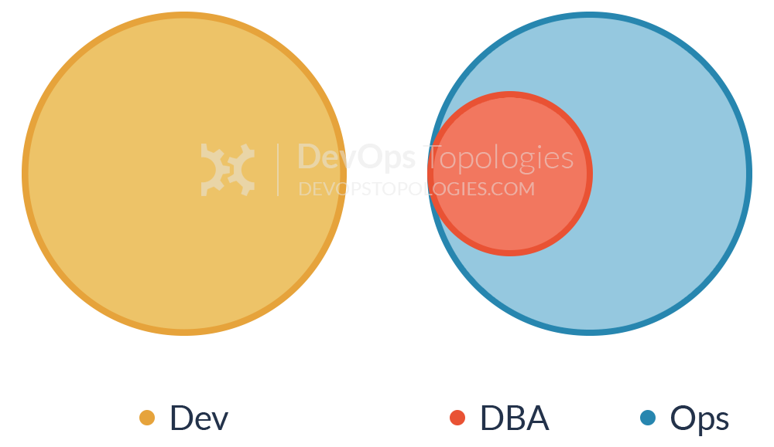
Anti-Type G: Dev and DBA Silos
This is a form of Anti-Type A (Dev and Ops Silos) which is prominent in medium-to-large companies where multiple legacy systems depend on the same core set of data.
Because these databases are so vital for the business, a dedicated DBA team, often under the Ops umbrella, is responsible for their maintenance, performance tuning and disaster recovery.
Notes:
That is understandable:
The problem is when this team becomes a gate keeper for any and every database change, effectively becoming an obstacle to small and frequent deployments (a core tenet of DevOps and Continuous Delivery).
Furthermore, just like Anti-Type A Ops in the DBA team is not involved early in the application development, thus data problems (migrations, performance, etc) are found late in the delivery cycle. Coupled with the overload of supporting multiple applications databases, the end result is constant firefighting and mounting pressure to deliver.

Slide 39
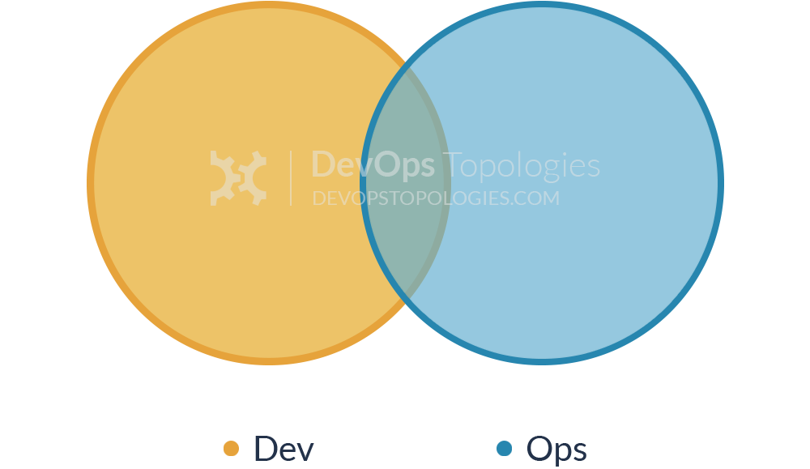
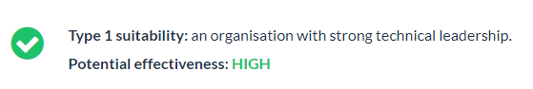
Type 1: Dev and Ops Collaboration
This is the ‘promised land’ of DevOps:
Smooth collaboration between Dev teams and Ops teams, each specializing where needed, but also sharing where needed.
There are likely many separate Dev teams, each working on a separate or semi-separate product stack.

Slide 40
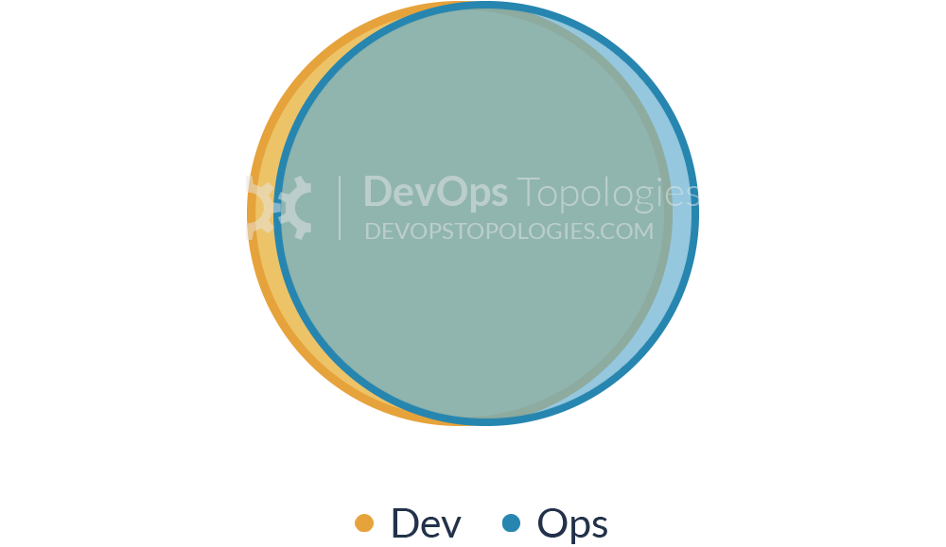
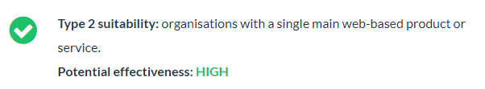
Type 2: Fully Shared Ops Responsibilities
There is so little separation between Dev and Ops that all people are highly focused on a shared purpose.
It’s probably not hugely applicable outside a narrow product focus, because the budgetary constraints and context-switching typically present in an organization with multiple product streams will probably force Dev and Ops further apart (say, back to a Type 1 model).
Notes:
This topology might also be called ‘NoOps‘, as there is no distinct or visible Operations team (although the Netflix NoOps might also be Type 3 (Ops as IaaS)).

Slide 41
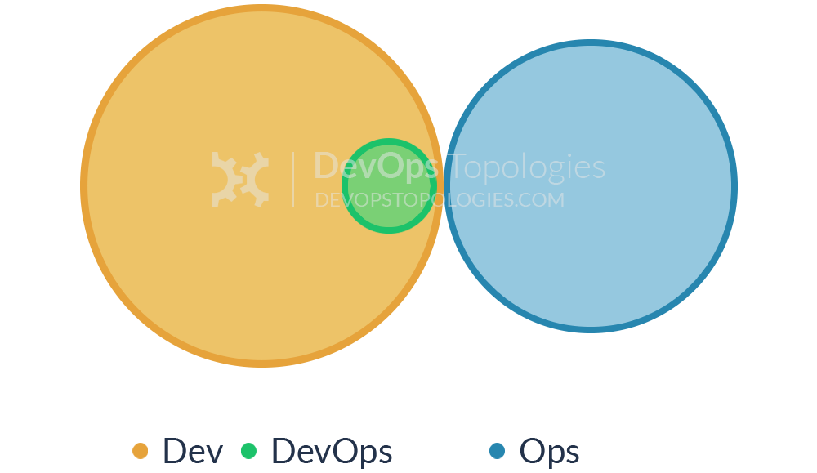
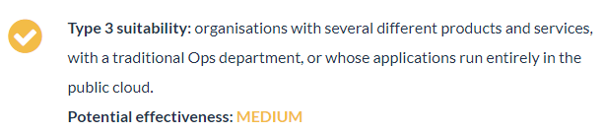
Type 3: Ops as Infrastructure-as-a-Service (Platform)
For organizations with a traditional IT Operations department which cannot change rapidly [enough], and for organizations who run all their applications in the public cloud, it probably helps to treat Operations as a team who simply provides the elastic infrastructure on which applications are deployed and run; the internal Ops team is thus directly equivalent to Infrastructure-as-a-Service.
A team (perhaps a virtual team) within Dev then acts as a source of expertise about operational features, metrics, monitoring, server provisioning, etc., and probably does most of the communication with the IaaS team. This team is still a Dev team, however, following standard practices like TDD, CI, iterative development, coaching, etc.
Notes:
The IaaS topology trades some potential effectiveness (losing direct collaboration with Ops people) for easier implementation, possibly deriving value more quickly than by trying for Type 1 (Dev and Ops Collaboration) which could be attempted at a later date.
The IaaS topology trades some potential effectiveness (losing direct collaboration with Ops people) for easier implementation, possibly deriving value more quickly than by trying for Type 1 (Dev and Ops Collaboration) which could be attempted at a later date.

Slide 42
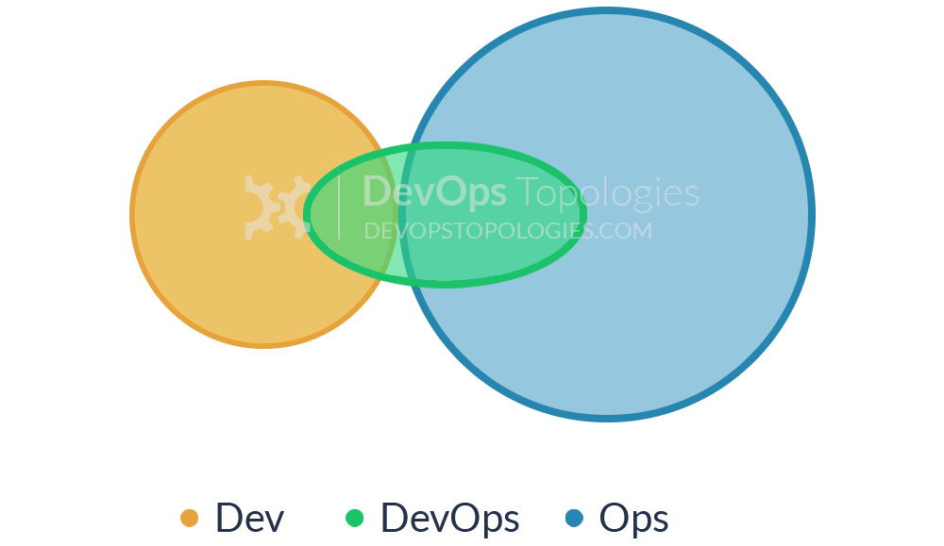
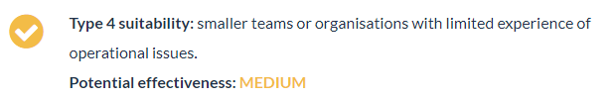
Type 4: DevOps as an External Service
Some organizations, particularly smaller ones, might not have the finances, experience, or staff to take a lead on the operational aspects of the software they produce.
The Dev team might then reach out to a service provider like Rackspace to help them build test environments and automate their infrastructure and monitoring, and advise them on the kinds of operational features to implement during the software development cycles.

Slide 43
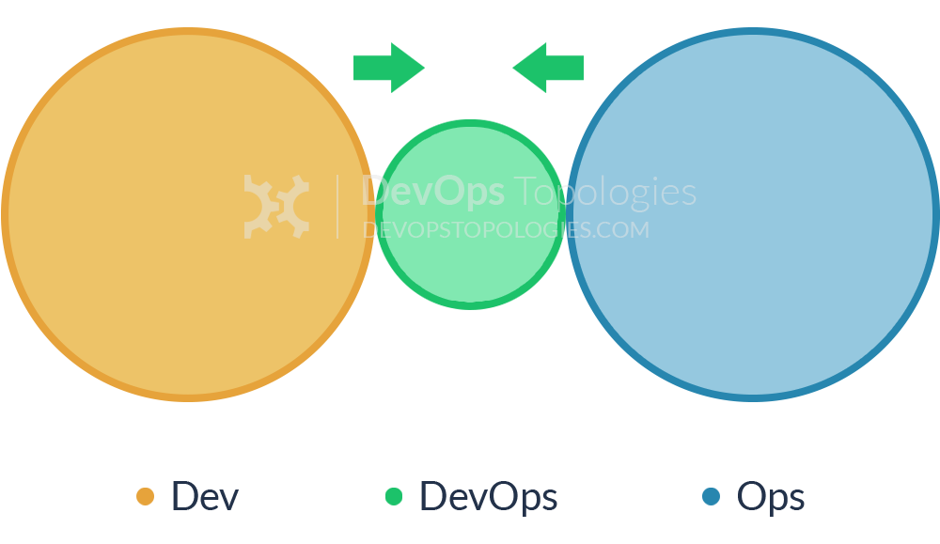
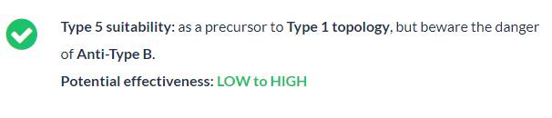
Type 5: DevOps Team with an Expiry Date
The DevOps Team with an Expiry Date looks substantially like Anti-Type B (DevOps Team Silo), but its intent and longevity are quite different.
This temporary team has a mission to bring Dev and Ops closer together, ideally towards a Type 1 (Dev and Ops Collaboration) or Type 2 (Fully Shared Ops Responsibilities) model, and eventually make itself obsolete.
The members of the temporary team will ‘translate’ between Dev-speak and Ops-speak, introducing crazy ideas like stand-ups and Kanban for Ops teams, and thinking about dirty details like load-balancers, management NICs, and SSL offloading for Dev teams.
Notes:
If enough people start to see the value of bringing Dev and Ops together, then the temporary team has a real chance of achieving its aim; crucially, long-term responsibility for deployments and production diagnostics should not be given to the temporary team, otherwise it is likely to become a DevOps Team Silo (Anti-Type B).
If enough people start to see the value of bringing Dev and Ops together, then the temporary team has a real chance of achieving its aim; crucially, long-term responsibility for deployments and production diagnostics should not be given to the temporary team, otherwise it is likely to become a DevOps Team Silo (Anti-Type B).

Slide 44
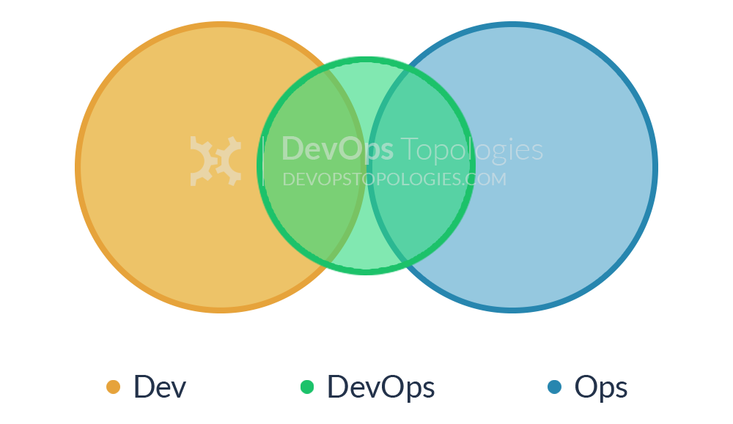
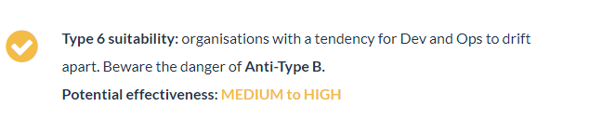
Type 6: DevOps Advocacy Team
Within organizations that have a large gap between Dev and Ops (or the tendency towards a large gap), it can be effective to have a 'facilitating' DevOps team that keeps the Dev and Ops sides talking.
This is a version of Type 5 (DevOps Team with an Expiry Date) but where the DevOps team exists on an ongoing basis with the specific remit of facilitating collaboration and cooperation between Dev and Ops teams.
Members of this team are sometimes called 'DevOps Advocates', because they help to spread awareness of DevOps practices.

Slide 45
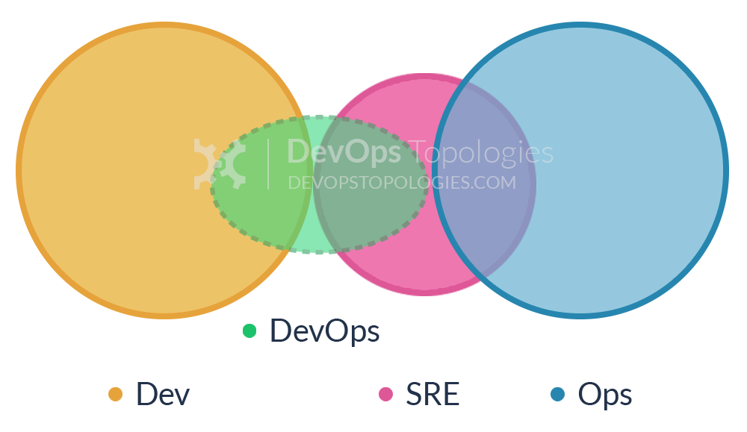
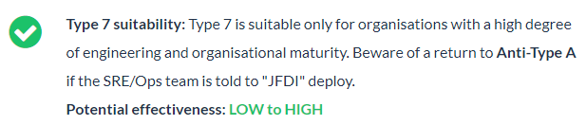
Type 7: SRE Team (Google Model)
DevOps often recommends that Dev teams join the on-call rotation, but it's not essential.
In fact, some organizations (including Google) run a different model, with an explicit 'hand-off' from Development to the team that runs the software, the Site Reliability Engineering (SRE) team.
In this model, the Dev teams need to provide test evidence (logs, metrics, etc.) to the SRE team showing that their software is of a good enough standard to be supported by the SRE team.
Notes:
Crucially, the SRE team can reject software that is operationally substandard, asking the Developers to improve the code before it is put into Production.
Collaboration between Dev and SRE happens around operational criteria but once the SRE team is happy with the code, they (and not the Dev team) support it in Production.
JFDI: Just Fearlessly Do It
https://mattkimber.co.uk/jfdi-deployment/

Slide 46
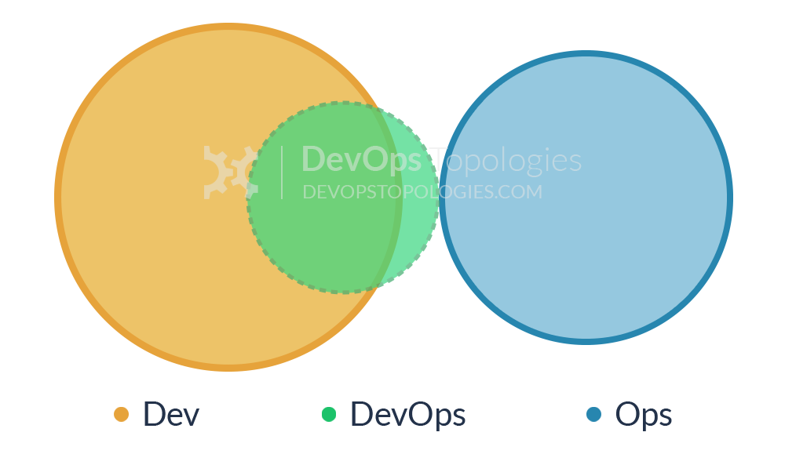
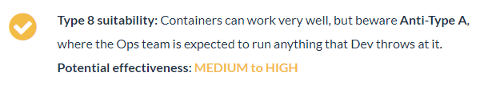
Type 8: Container-Driven Collaboration
Containers remove the need for some kinds of collaboration between Dev and Ops by encapsulating the deployment and runtime requirements of an app into a container.
In this way, the container acts as a boundary on the responsibilities of both Dev and Ops.
With a sound engineering culture, the Container-Driven Collaboration model works well, but if Dev starts to ignore operational considerations this model can revert towards to an adversarial 'us and them’.

Slide 47
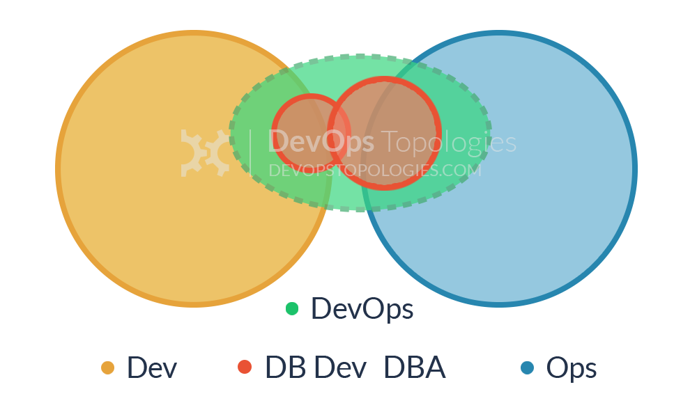
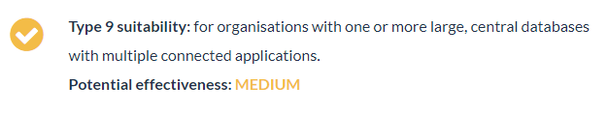
Type 9: Dev and DBA Collaboration
In order to bridge the Dev-DBA chasm a database capability from the DBA team is complimented with a database capability (or specialism) from the Dev team.
This help to translate between the Dev-centric view of databases (as essentially dumb persistence stores for apps) and the DBA-centric view of databases (smart, rich sources of business value).

Slide 48
Enable Every Team Member to Be a Generalist

Slide 49
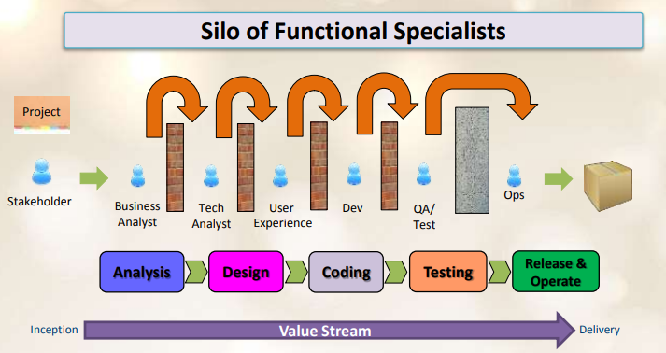
Waterfall with functional-orientation

Slide 50
Do not dismiss functional-orientation entirely
Over-specialization, an extreme consequence of functional-orientation, can cause siloization.
To counter this, encourage people to become generalists by providing varied opportunities for skills development.
Encourage a growth mindset in the organization and hire for generalist skills.

Slide 51
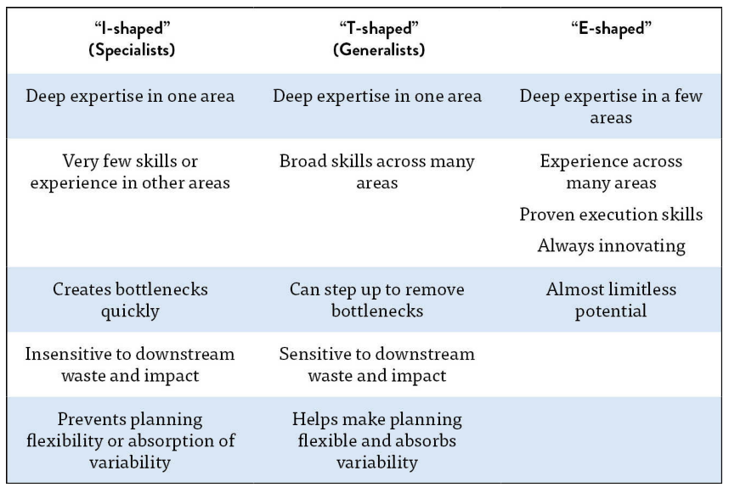
From I-Shaped to T-Shaped

Slide 52
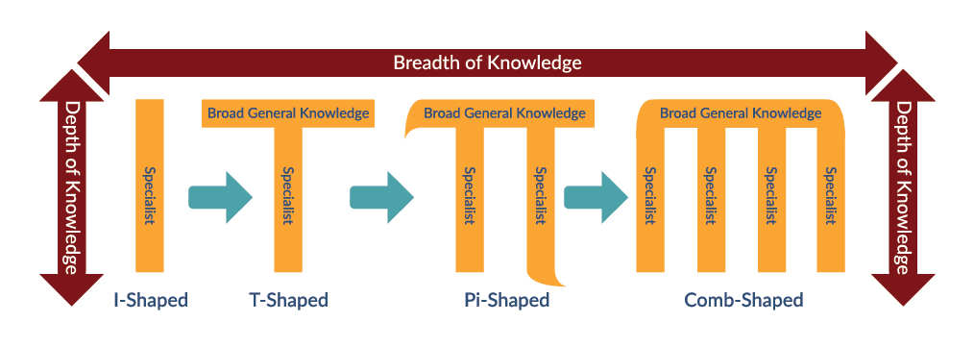
More shapes?
52
Notes:
T-shaped skills Shaped in the form of a T the person has a broad base with one area of expertise
Pi shaped skills Broad base with two expertise areas which gives the shape of Pi
Comb shaped skills Broad base with multiple expertise areas which gives the shape of a comb

Slide 53
Design Team Boundaries in Accordance with Conway’s Law

Slide 54

CONWAY’S LAW
“Organizations which design systems… are constrained to produce designs which are copies of the communication structures of these organizations”
-- M. Conway
Notes:
CONWAY’S LAW HAS A TREMENDOUS IMPACT ON THE PERFORMANCE OF OUR VALUE STREAM.

Slide 55

CONWAY’S LAW
In 1968, Dr. Conway was performing a famous experiment:
Together, with a contract research organization of eight people, they were commissioned to produce a COBOL and an ALGOL compiler.
During the experiment, he observed:
“After some initial estimates of difficulty and time, five people were assigned to the COBOL job and three to the ALGOL job.
The resulting COBOL compiler ran in five phases, the ALGOL compiler ran in three.”

Slide 56
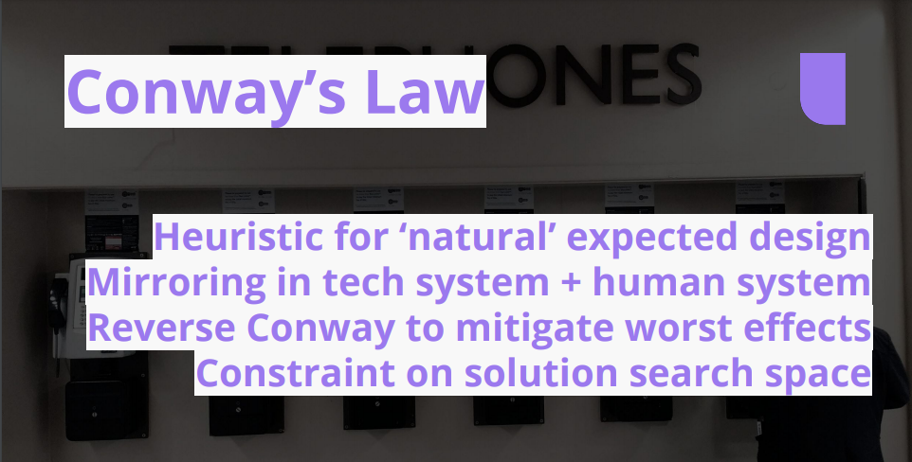
CONWAY’S LAW

Slide 57
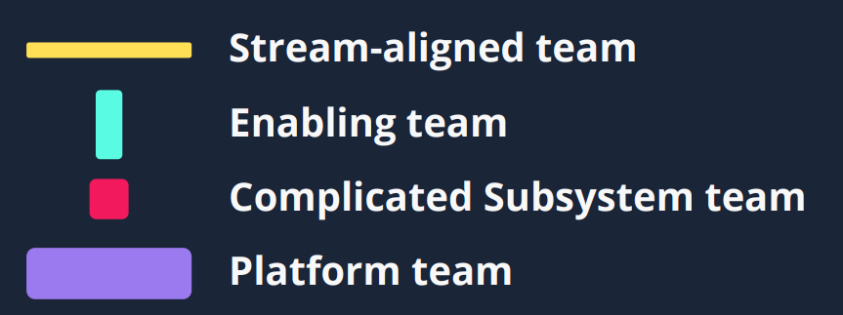
4 fundamental topologies for fast flow
Notes:
CONWAY’S LAW HAS A TREMENDOUS IMPACT ON THE PERFORMANCE OF OUR VALUE STREAM.

Slide 58
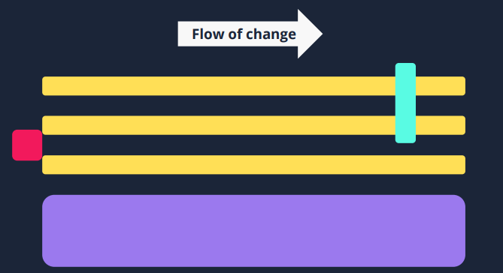
4 fundamental topologies for fast flow

Slide 59
3 core interaction modes

Slide 60
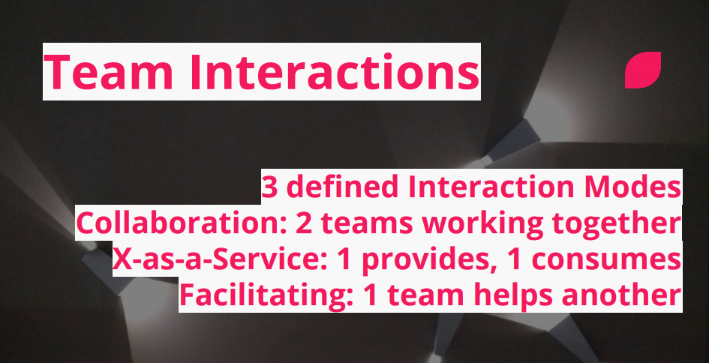
3 core interaction modes

Slide 61

Triggers for change

Slide 62

Triggers for change

Slide 63

Team Topologies for fast flow

Slide 64
Rethink team structures, purpose and interaction

Slide 65

Explicit cognitive load

Slide 66

Large Conway mismatches

Slide 67

Team Interactions

Slide 68

Thinnest Viable Platform

Slide 69


The “Spotify model” helps to

Slide 70

We also need to address

Slide 71
Case studies: Spotify

Slide 72

The Spotify model

Slide 73

The Spotify model
Notes:
Henrik Kniberg & Anders Ivarsson, 2012
https://blog.crisp.se/wp-content/uploads/2012/11/SpotifyScaling.pdf

Slide 74

Case studies: Amazon

Slide 75

Vision
75

Slide 76

Jeff Bezos’ Big Mandate (2001) Steve Yegge’s Architecture Rant
76

Slide 77

A Look Back: Development transformation

Slide 78

Every Team is a DevOps team
78

Slide 79

Amazon S3 at launch

Slide 80

Amazon S3 today

Slide 81

The recipe
81

Slide 82

The recipe
82

Slide 83

The recipe
83

Slide 84

Pipelines
84

Slide 85

Monolith development lifecycle
85

Slide 86

Microservice development lifecycle
86

Slide 87

Pipelines
87
Notes:
•2011: Amazon performs approximately seven thousand deploys per day
•2015: 130,000 deploys per day • ~50 million deploys/year

Slide 88

2 Pizza Team Responsibility Venn Diagram
88

Slide 89

2 Pizza Team Responsibility Venn Diagram
89

Slide 90

Practices and Patterns
90

Slide 91

Automate everything
91

Slide 92

Belts and suspenders
92

Slide 93

Standardize Tools
93

Slide 94
Culture Foundation

Slide 95
Common DevOps Practices
Discovery Practices | Delivery Practices | Culture of Collaboration practices | Technical Practices
Impact Mapping | Kanban | Social Contracting | Infrastructure as Code
Event Storming | Scrum | Team Sentiment | Continuous Integration
Value Stream Mapping | Visualisation of work | Realtime Retrospectives | Continuous Delivery
Metrics Based Process Mapping | Burnup/ Burndown | Backlogs | Test Automation
 | Retrospectives | Pairing | Test Driven Development
 | Definitions of Ready & Done | Mobbing
 | Estimation
95

Slide 96
Pairing and mobbing: Discuss and experience 3 foundational practices

Slide 97

Pair programming can be slow and frustrating

Slide 98
Pair programming Why use it?
Enable knowledge sharing between team members.
Building of trust between team members.
Increased quality of work as it is reviewed and improved simultaneously.
It is not for:
Teaching domain, Mentorship, Showing code, Getting confirmation or Finding bugs
98

Slide 99
Pair programming How to do it?
The team member behind the keyboard and mouse is the driver.
The driver is focused on performing the actual work.
The other team member is the navigator or observer.
The navigator is focused on the strategic outcome of the work being performed.
The navigator reviews the work being performed by the driver as it is done.
While reviewing, the navigator keeps in mind the end goal and ensures the current task is working towards it.
Switch the roles often, for example every 15 minutes, for the team members to experience the different aspects of the work.
99

Slide 100

Pair programming with A
100

Slide 101

Ping-Pong Programming
Ping-Pong Programming (aka. Ping-Pong Pair Programming) is a kind of Pair Programming that TDD (Test Driven Development) is included while in practice.
101

Slide 102
Ping-Pong Programming Why use it?
Easier to find the rhythm of the development flow which can be a problem when it comes to switching pairs.
TDD !!
A much smaller problem space needs to be managed, so this enables developers to sync with the flow quicker than other styles.
The work is gamified, so it puts another kind of motivation for developers.
Avoids mismatched pair issues -like one developer knows more than the other- as each developer takes turns writing tests and making them pass.
102

Slide 103

Ping-Pong Programming How to do it?
103
Notes:
The optimal setup to work in this rhythm is two developers sitting side by side, a single computer with two input devices:
That’s two monitors, two keyboards, and two mice. However, developers may do pairs remotely if they work in a remote environment via tools like Live Share etc.

Slide 104
Mob Programming What is it?
Mob programming is a practice where the whole team comes together to implement a feature or piece of functionality.
Like pair programming but with the whole team.
This practice can also be used as Mob learning when you quickly want to share new information that everyone in the team needs.
- Ensures the whole team understands how a specific feature is implemented or problem is solved.
- It can also be a quick way to onboard new team members.
104

Slide 105

Mob Programming How to do it?
105

Slide 106

Mob Programming How to do it?
Have one team member driving a laptop that is connected to a large screen or projector.
The person behind the keyboard and mouse is usually called “Driver” and the others would be “Navigators”.
The whole team then implement the feature together by talking through the development together.
106

Slide 107
Service model and technical practices

Slide 108

Service Model The Old Way: Assembly Line IT
108

Slide 109

Model 1: “Legacy”
109

Slide 110

Each Server Built This Way is A “Pet”
110

Slide 111

Model 2: Robotics Factory IT
111

Slide 112

Every Server is Just Another Part of the Herd
112

Slide 113

Model 1 vs Model 2
113

Slide 114

Every Server is Just Another Part of the Herd
114

Slide 115

Failures happen … Always
- Everything must fail without an impact:
Server components, servers, racks, datacenters … Everything!
- Most importantly, apps must detect and route around these failures.
115

Slide 116

Everything-as-Code Save everything as code: configuration, infrastructure and pipelines
- This means, storing configuration along with Source Code in an SCM.
- Storing the configuration from bottom to top (communication switches, bare metal servers, operating systems, build configurations,
application properties and deployment configurations…) as code means they are tracked and can be recreated at the click of a button.
116
Notes:
Everything as Code includes system design, also stored as code. In old world IT, infrastructure required specialized skills and physical hardware and cables to be installed.
Systems were precious or were not touched / updated often as the people who created them no longer work for the company.
The dawn of cloud computing and cloud native applications has meant it is cheap and easy to spin up virtual infrastructure.
By storing the configuration of virtual environments as code, they can be life-cycled and recreated whenever needed.

Slide 117
Why store all things as code?
1- Traceability:
Storing your config in git implies controls are in place to track who / why a config has changed.
Changes can be applied and reverted and are tracked to a single user who made the change.
117

Slide 118
Why store all things as code?
2- Repeatable:
Moving from one cloud provider to another should be simple in modern application development.
Picking a deployment target should be like shopping around for the best price that week.
By storing all things as code, systems can be re-created in moments in various providers.
118

Slide 119
Why store all things as code?
3- Tested:
Infra and code can be rolled out, validated and promoted into production environments with confidence and assurance it will behave as expected.
119

Slide 120
Why store all things as code?
4- Phoenix server:
No more fear of a servers’ configuration drifting.
If a server needs to be patched or randomly dies, it’s OK.
Just create it again from the stored configuration.
120

Slide 121
Why store all things as code?
5- Shared understanding:
When a cross-functional team is using ‘Everything as Code’ to describe all the parts of the Product they are developing together, they contribute to increase the shared understanding between Developers and Operations.
They speak same language to describe the state of this Product and they use the same frameworks to accomplish their goals.
121

Slide 122
Best practices
122

Slide 123


Best practices
123

Slide 124
Demo day: Experiment with the optimal methods of producing a showcase.

Slide 125
Showcase What is it?
An event where stakeholders and interested parties are given a demonstration of recent work performed by a team.
The latest increment of the product with new features built by the the team is showcased.
The event also provides an opportunity to review all other work (including non-functional progress) performed by the team.
Often performed at the end of an iteration (a.k.a Sprint Review or Iteration Demo) but can be performed at key milestones in the life of the product and, indeed, can be scheduled at any time where feedback would be useful.
125

Slide 126
Showcase Why use it?
This provides a critical feedback loop for products being incrementally and iteratively built as stakeholders can feed back on the features as they are being built into the product, suggest improvements, new ideas for features and catch problems or defects with the product early.
It provides an open forum for channeling feedback from stakeholders into the product leadership so that the prioritization and future work can be adapted accordingly.
It provides an open forum for channeling feedback from stakeholders into the product leadership so that the prioritization and future work can be adapted accordingly.
126
Notes:
It also enables collaboration across all interested parties on a regular basis and facilitates conversation on the future direction of the product.

Slide 127
Showcase Advice
Where possible avoid scripting the showcase give stakeholders/end users the ability to play around with the new product.
Showcases should be as interactive as possible, aiding the team in collecting real world feedback
Showcases should be a comfortable and open environment for people to speak freely.
Encourage negative as well as positive feedback, this is the only way to ensure that you’re building the right thing
127

Slide 128
Showcase Advice
The showcase is particularly important in a remote delivery as it is the primary if not the only opportunity to show the value that has been delivered during the sprint in the absence of the team being co-located.
Agree agenda and demo roles with the team, and use a timer to ensure you timebox the presentation.
Facilitator is key to allow the team complete the demo uninterrupted and then allow stakeholders to give feedback and ask questions.
Record the session and create showcase video.
128
Notes:
Use available online tools and emulators where possible.

Slide 129
Retrospectives, information radiators, and team sentiment

Slide 130
Retrospectives
Retrospectives facilitate continuous improvement.
Rather than wait until the end of a project to run a full “lessons learned” exercise for the entire delivery, we encourage taking short time boxes during delivery for the team to course correct and find ways to improve their way of working.
This should come in the form of actions agreed by the team with owners and estimated time due dates, allowing for tracking and helping to ensure their completion.
130

Slide 131

Retrospective
131

Slide 132

Retrospective
132

Slide 133
Why retrospectives?
Retrospectives facilitate continuous improvement.
Rather than wait until the end of a project to run a full “lessons learned” exercise for the entire delivery, we encourage taking short time boxes during delivery for the team to course correct and find ways to improve their way of working.
This should come in the form of actions agreed by the team with owners and estimated time due dates, allowing for tracking and helping to ensure their completion.
133

Slide 134
Retrospective Advice
Be careful not to dwell too heavily on things outside of the teams control. Ensure you track them and raise them to the relevant owners but value can rarely be found in a one hour ranting session.
Retro’s are within reason whatever a team needs it to be.
They can be broad and encompass multiple issues and problems, or with the teams permission can drill down into specific issues using techniques such as the 5 whys.
Locations can play a major role in the outcome of a Retrospective. Changing a Retro location to a Cafe, pub or even using techniques such as the walking retro can help to drive out different problems/issues that might not have come up otherwise
134

Slide 135

Team Sentiment
Team Sentiment practices track the mood of a team and provide a mechanism for team members to rapidly feed back, either publically or anonymously, when their mood has changed.
135

Slide 136

Team Sentiment
136

Slide 137
Why use a Team Sentiment practice?
Team sentiment practices enable problems to be identified, radiated and addressed early.
This enable the team to quickly discuss where one or more team members is suddenly troubled by the direction their work is going.
Can also provide an information radiator to assess the overall team health and feeling.
137

Slide 138
Lean Coffee Metrics for Software Teams

Slide 139

Why store all things as code?
139

Slide 140
Summary

Slide 141

Create Permanent Teams Around Core Products

Slide 142

To Achieve Velocity, You Need Complete Teams

Slide 143

Understand Your Customers and Value Streams

Slide 144

Put the Spotlight on Bottlenecks

Slide 145

Do Away with Inconsistent Environments

Slide 146

Automate the Path to Production

Slide 147

Build in Quality Up-front

Slide 148

Break Down Communication Barriers

Slide 149

Rethink and Rebuild your Teams

Slide 150
Questions?

